Slide 1
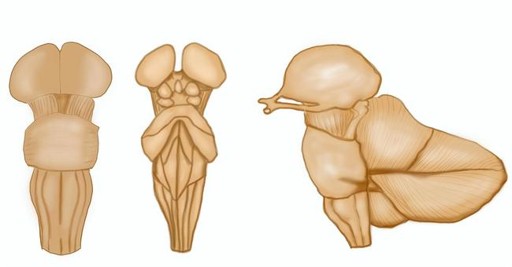
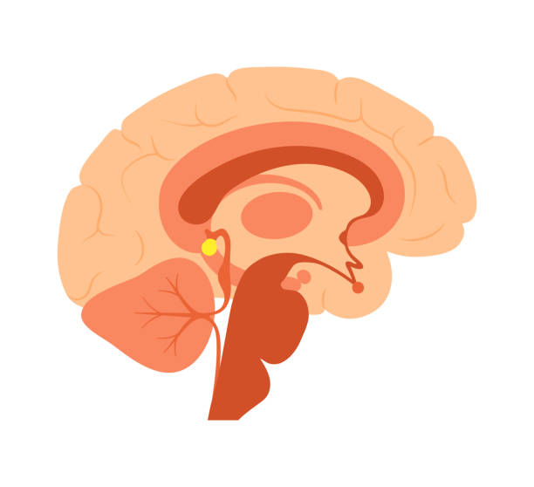
Chapter 13-14: Internal Structures and Vascular Supply of the Brainstem
Nlotachika Akaneme, Brandon Price, Samin Urooj, James Anderson, Nicki Dell

Slide 2
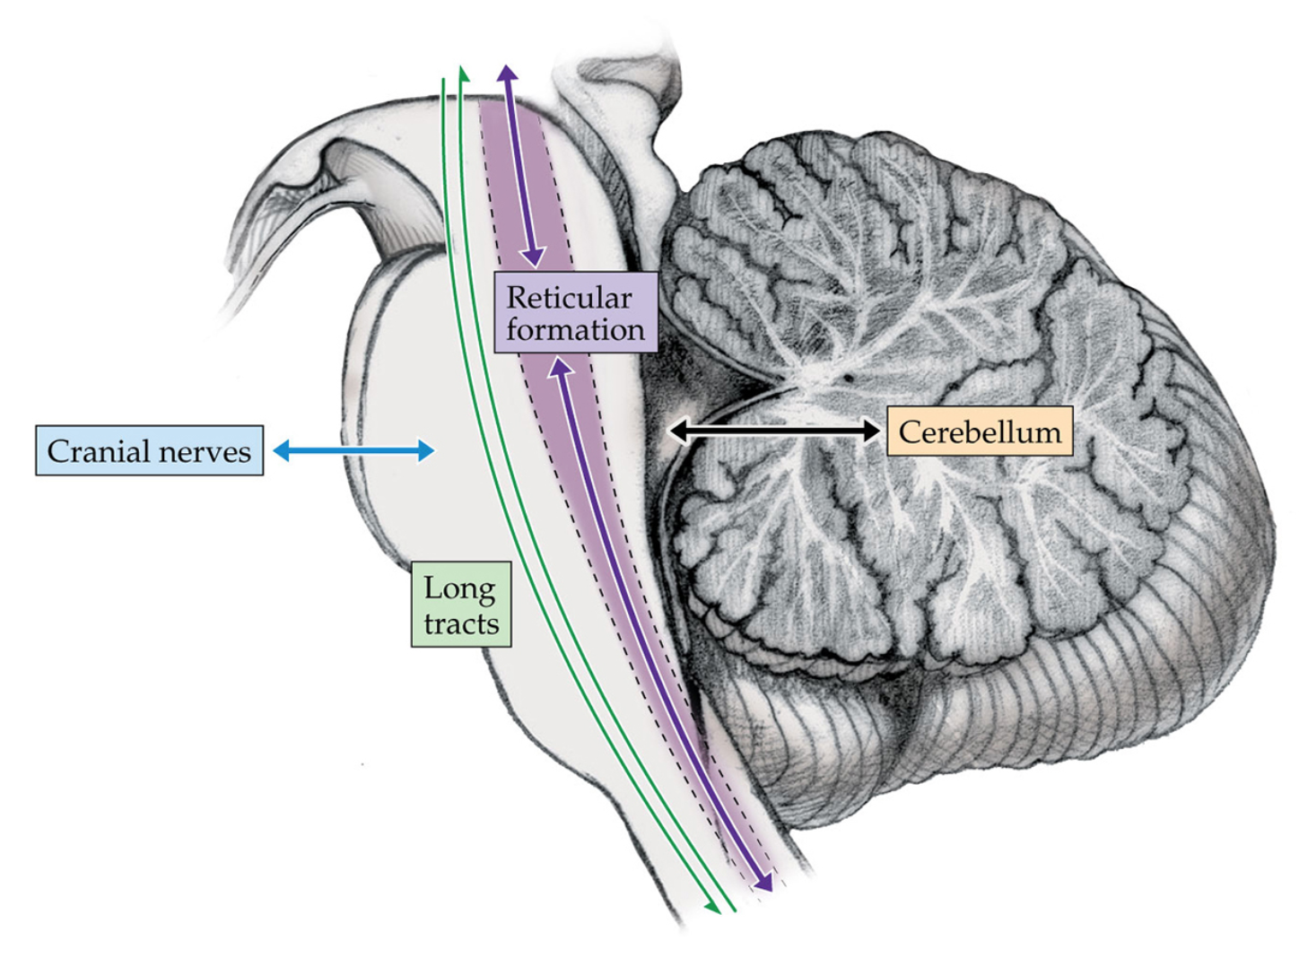
The Main Components of the Brainstem
Cranial nerve nuclei and related structures
Long tracts
Cerebellar circuitry
Reticular formation and related structures
Notes:
James

Slide 3
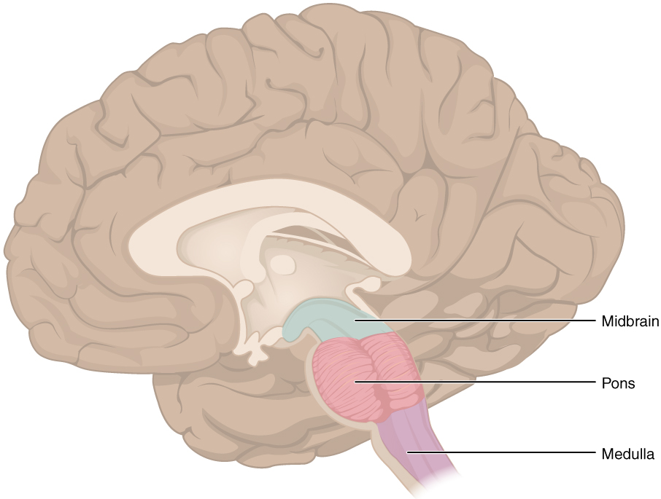
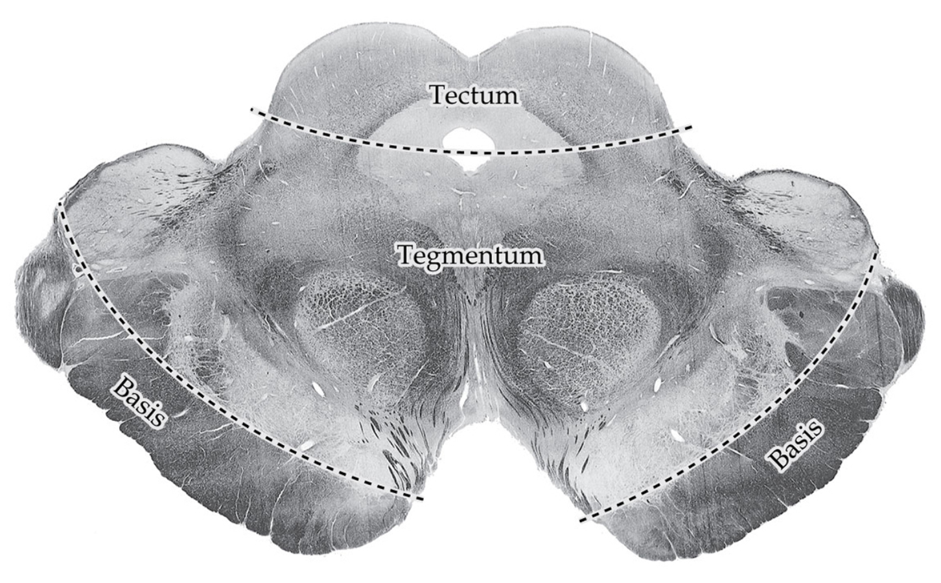
Brainstem Sections
Brainstem is composed of midbrain, pons, and medulla
Tectum
“Roof” in latin
Only noticeable in midbrain
Consists of inferior and superior colliculi
Tegmentum
“Covering”
Main bulk of reticular formation and brainstem nuclei
Basis
Made of fibers that make up the corticospinal and corticobulbar tracts
Dorsal
Ventral
Notes:
James

Slide 4
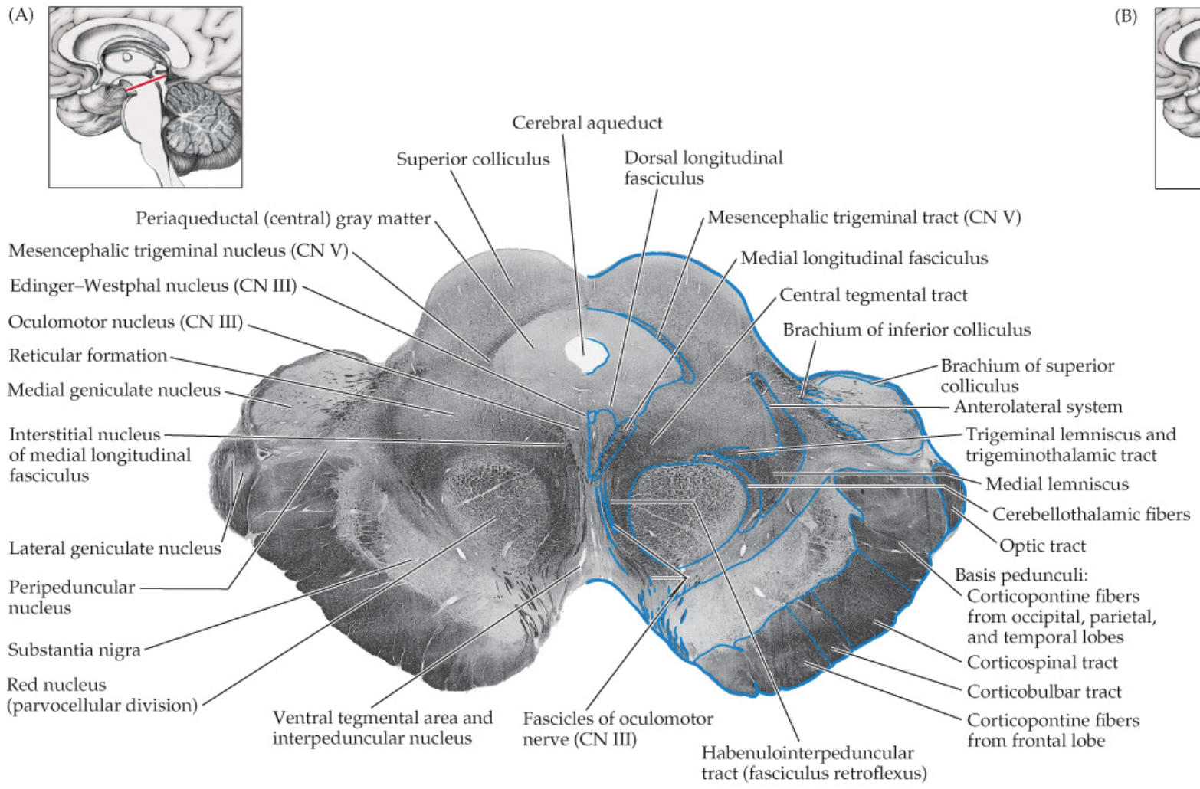
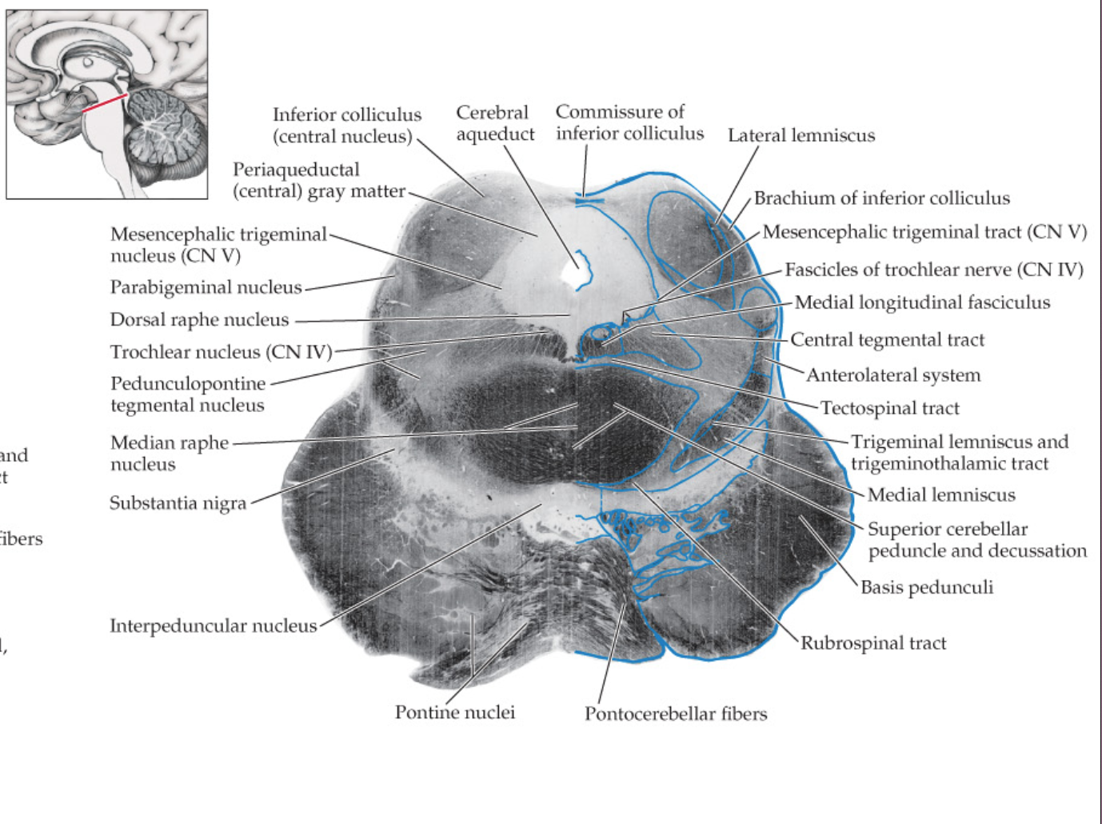
Midbrain
Section through superior colliculi
Contains oculomotor nuclei and red nuclei
Section through inferior colliculi
Contains trochlear nuclei and brachium conjunctivum
Other landmark structures
Cerebral aqueduct
Periaqueductal gray
Midbrain reticular formation
Medial lemniscus
Cerebral peduncles
Notes:
James

Slide 5
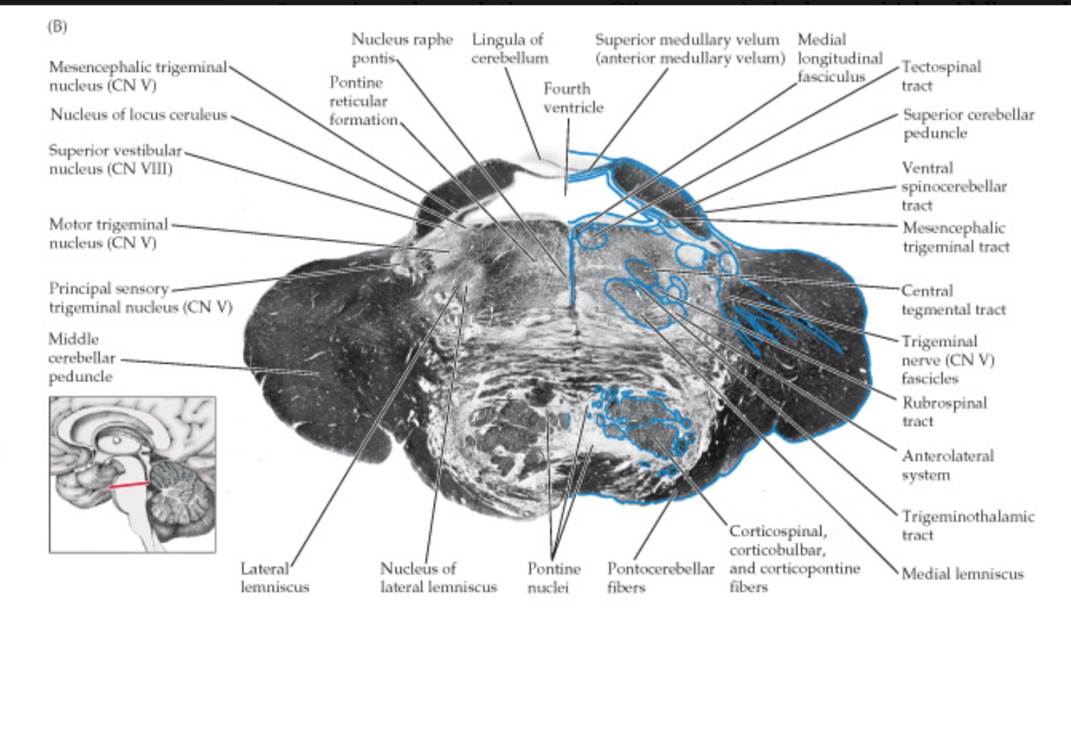
Pons
Middle cerebellar peduncles on each side laterally
Ventral pons home to basis pontis
Basis pontis includes corticospinal tract corticobulbar tract, pontine nuclei
4th ventricle separates pontine tegmentum from cerebellum

Slide 6
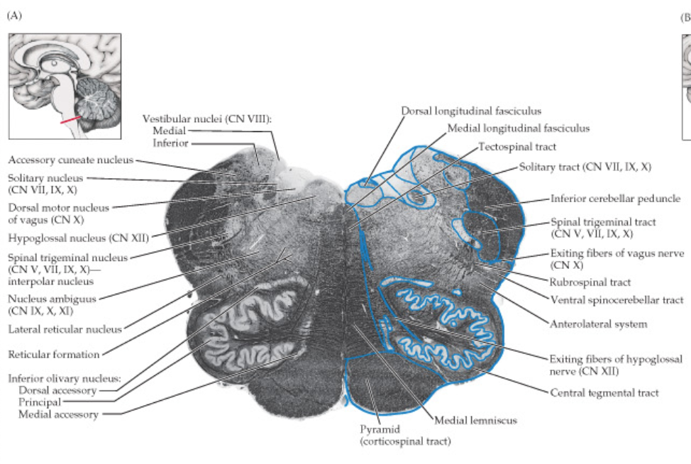
Medulla
Rostral medulla
Contains inferior olivary nucleus and 4th ventricle
Caudal medulla
Contains posterior column and posterior column nuclei
Other landmark structures
inferior cerebellar peduncles
pyramidal tracts
anterolateral system
medial lemniscus
Transition from medulla to spinal cord is marked by pyramidal decussation

Slide 7
Cranial Nerve Nuclei
Columns of motor nuclei:
Somatic Motor Nuclei (GSE): Oculomotor, Trochlear, Abducens and Hypoglossal nuclei
Branchial Motor Nuclei (SVE):Trigeminal motor nucleus, Facial and Spinal Accessory Nucleus
Parasympathetic Nuclei (GVE): Edinger-Westphal nucleus, superior and inferior salivatory nuclei.
Columns of sensory nuclei
General Somatic Sensory (GSA): CN V, VII, IX, X; all travel to the trigeminal nuclear complex.
Special Somatic Sensory (SSA): Inputs for hearing and vestibular sense, CN VIII, reach the cochlear and vestibular nuclei
Notes:
Lota

Slide 8
Long Tracts
Major Long tracts:
Corticospinal Tract: Axons communicating motor information between the brain and spinal cord
Corticobulbar Tract: carries upper motor neuron input to motor nuclei of trigeminal, facial, glossopharyngeal, vagus, accessory, and hypoglossal nerves
Notes:
Lota

Slide 9
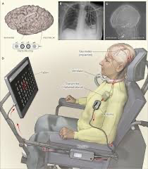
Locked-in Syndrome
Absent motor function with sensory input and cognition still present
Patients are said to be “locked in” their bodies
Usually caused by a lesion in the ventral pons, where the spinal cord receives no motor input from Long motor tracts.
Notes:
Lota

Slide 10
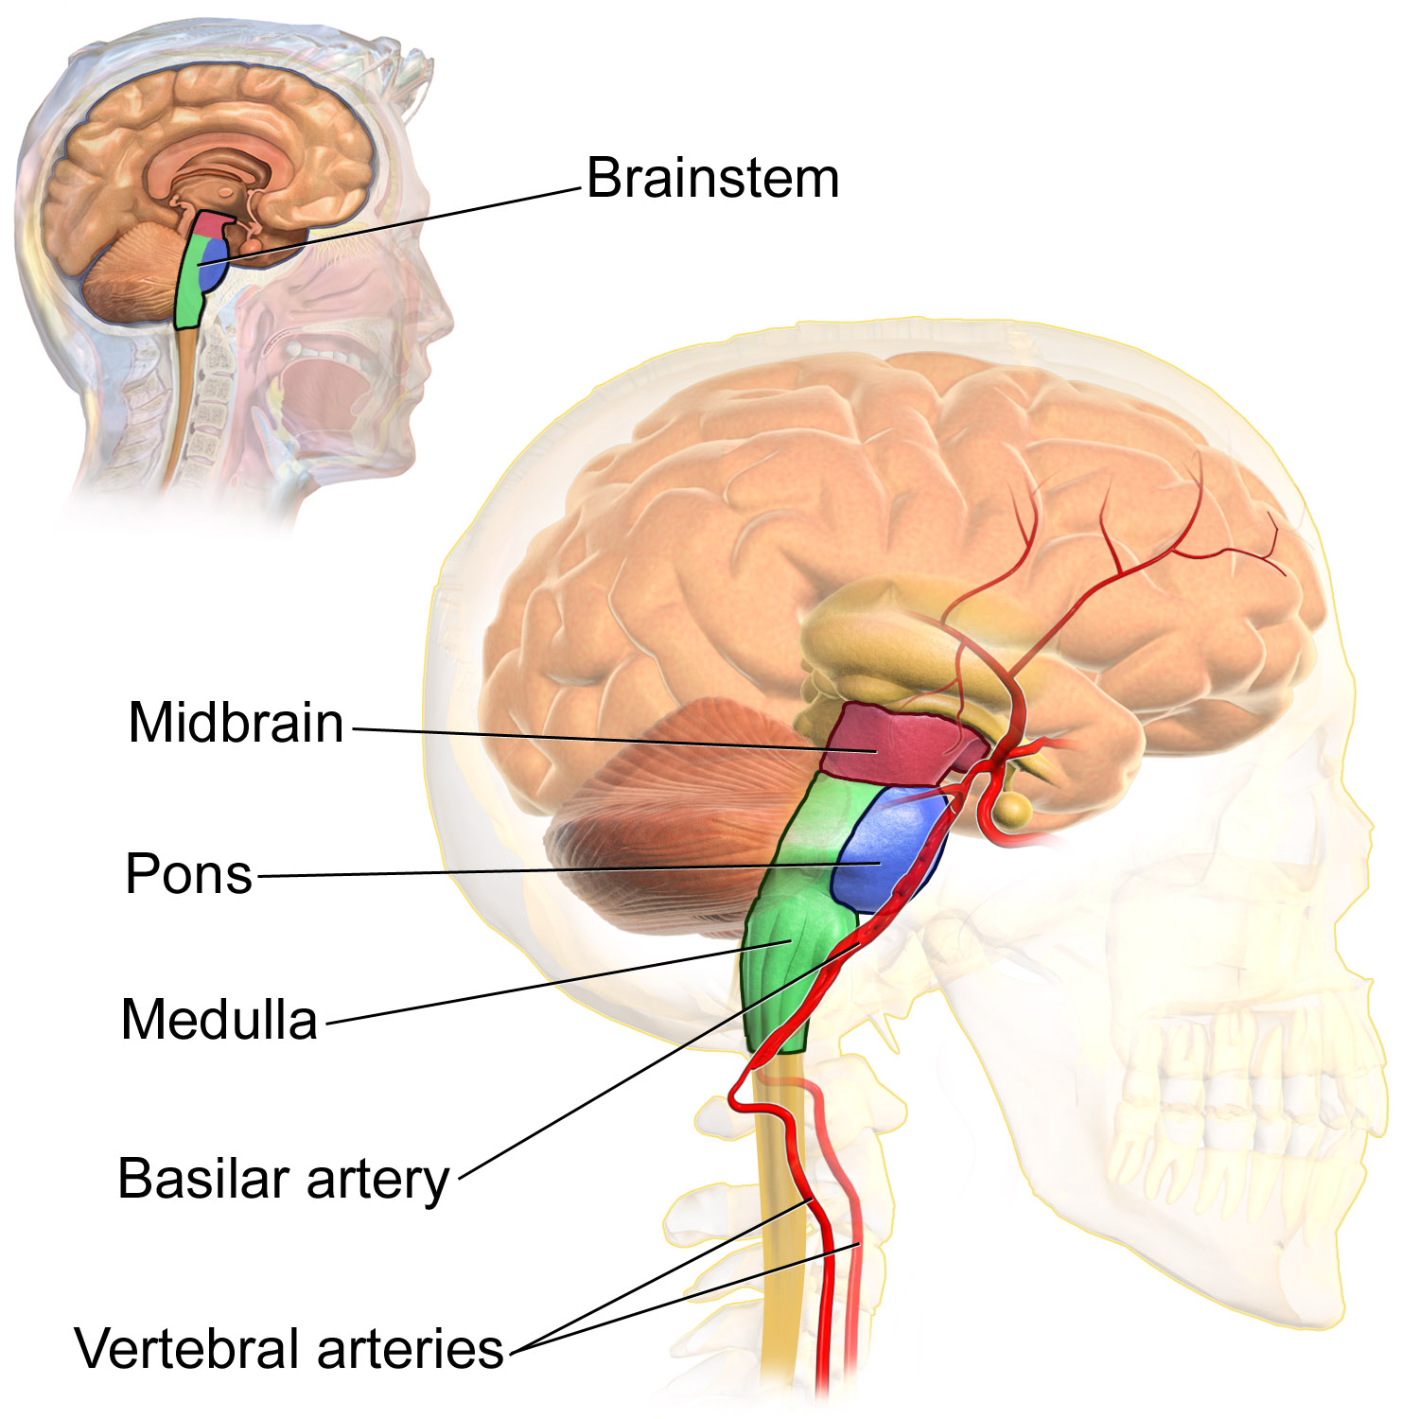
Vascular Supply of Brainstem
Vertebral Arteries: The brainstems main blood supply, travels the neck to the skull.
Basilar Artery: Vertebral arteries join to make the basilar artery, which lies in the front of the brainstem, providing blood to the midbrain, pons, and upper medulla.
Posterior Inferior Cerebellar Arteries (PICA): Comes from the vertebral and basilar arteries to provide blood support to the sides and back of the medulla and to supply the cerebellum.
Notes:
Brandon

Slide 11
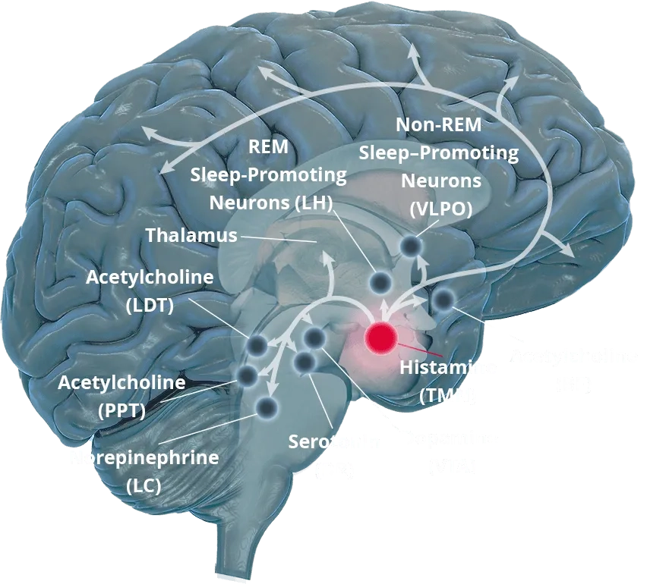
Histamine
Origin: Comes from the posterior hypothalamus within the tuberomammillary nucleus.
Roles: Agent in regulating processes like gastric acid secretion, inflammation, and the control of vasodilation and bronchoconstriction.
Influence: Impacts many various regulatory mechanisms, such as causing allergic symptoms.
Notes:
Brandon

Slide 12
Consciousness System
Formed by:
cortical and subcortical networks in the brain
medial and lateral frontoparietal association cortex
arousal circuits in the upper brainstem and diencephalon
Two divisions:
Content of Consciousness
Level of Consciousness
Notes:
Nicki

Slide 13
Content of Consciousness
Level of Consciousness
Includes:
Sensory functions
Motor functions
Memory
Emotional functions
AAA
Alertness
Attention
Awareness
Notes:
Nicki

Slide 14

Kahoot! For Chapter 14
https://kahoot.it/challenge/09222637?challenge-id=a1b8986d-6cbf-49a0-9755-9d778736c903_1698860212666
Game PIN
09222637
Notes:
Nicki

Slide 15
References
Textbook: Blumenfeld, Hal. Neuroanatomy through Clinical Cases. Available from: University of Maryland Baltimore County, (3rd Edition). Oxford University Press Academic US, 2021.

